Slide 1
Attendance Management System
Introduction
For taking attendance
Asp.net
Web-online

Slide 2
Activity Diagram
Diagram in UML
For describing the dynamic aspects of the system
Flow chart

Slide 3
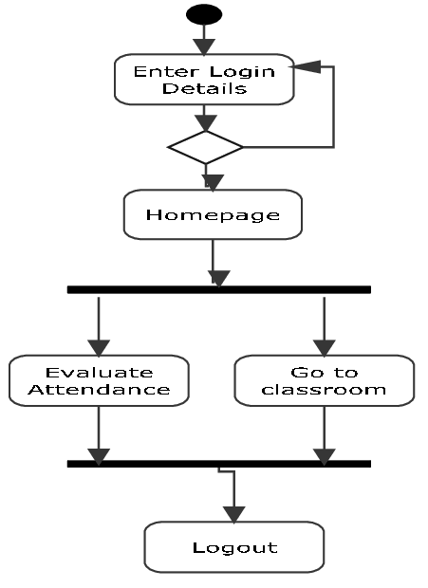

Slide 4
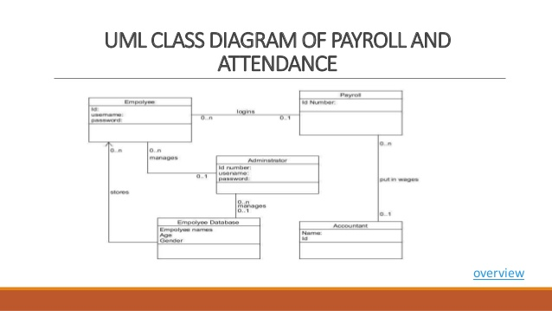
Class Diagram

Slide 5
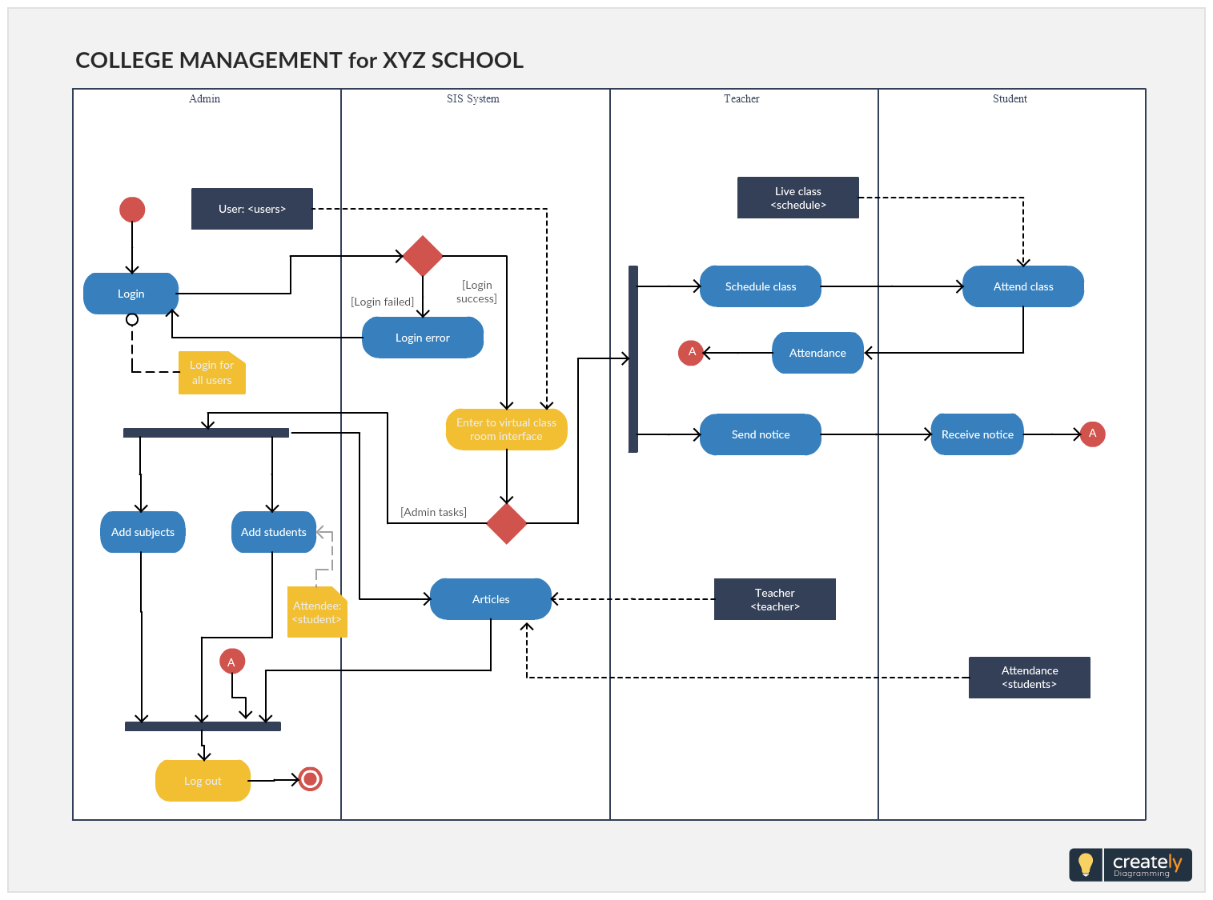
Full Activity Diagram

